Slide 1
New Grantee Orientation: Performance Reporting
Performance, Assessment, Research, and Evaluation (PARE) Unit
FY 2024 CY and EM grantees
12/10/24
1

Slide 2
Agenda
Describe the purposes of performance reporting
Clarify OVW’s approach to performance reporting
Explore guiding principles of performance reporting
Introduction to the VAWA IMPACT Tool
Review what we have learned through performance reporting from CY + EM grantees

Slide 3
Performance, Assessment, Research, and Evaluation Unit
Become an OVW peer reviewer:
www.justice.gov/ovw/peer-review
Learn more about our grants at:
www.justice.gov/ovw/grant-programs
Review performance reporting forms:
https://www.vawamei.org/grant-program/consolidated-youth-program/
Contact Information:
Olivia Storz: Mary.Storz@usdoj.gov
R&E email inbox: OVW.Research@usdoj.gov
The PARE Unit works to build the evidence base for Violence Against Women Act (VAWA)-funded programs, provide research and data to inform program and policy decisions, and equip people in the field with information and tools to help them align their work with effective strategies for serving survivors and holding offenders accountable.

Slide 4
OVW Uses Performance Reporting Data to:
Fulfill Congressional reporting requirements
Monitor awards
Testify before Congress
Respond to data requests
Evaluate and justify funding needs
Identify areas of remaining need
Identify trends and promising practices
Answer policy questions
Listen to our grantees and be responsive to the field

Slide 5
Thank you for all you do to coordinate quality data collection and share your work with OVW.

Slide 6
Guiding Principles of OVW Performance Reporting

Slide 7
Performance Reporting
OVW grant recipients should collect and must report sufficient and accurate performance data on their OVW-funded projects.
Grant recipients must maintain victim privacy and confidentiality and comply with civil rights regulations.
Recipients should ensure that all participants in OVW-funded programming understand how the data they share will be used and who can access to it.
Data should be collected to the extent that it does not compromise the grant recipient’s ability to provide victim-centered, appropriate, equitable, and accessible services.
OVW grant recipients should report only on that are activities allowable under their grant conditions.

Slide 8
Guiding Principles
Victim-centered and Trauma-informed
Informed, Confidential, and Secure
Meaningful and Useful
Appropriate, Accessible, and Equitable

Slide 9
Victim Centered and Trauma Informed
Recipients should collect data about victims served, services provided, and other activities completed with OVW funds to the extent that it does not interfere with providing victim-centered, trauma-informed services.

Slide 10
Informed, Confidential, and Secure
When victims or participants share their data or participate in services, they should be informed about how, when, and by whom their data will be used and how their data will be stored.

Slide 11
Meaningful and Useful
Recipients should consider which data are meaningful, useful, and appropriate for the communities served.
Avoid asking additional questions of participants that do not directly relate to service provision and safety.
Fulfilling OVW reporting requirements should not mean placing an undue burden on participants.
OVW uses reports to monitor an award and report to Congress
Using narrative fields is a good was to provide more detail to OVW.

Slide 12
Appropriate, Accessible, and Equitable
Victims should never be required to share demographic information as a condition for receiving OVW-funded services.
Screening tools, intake forms, and other data collection mechanisms should be available in languages and formats to ensure meaningful access in communities served.

Slide 13
VAWA IMPACT Tool
Logistics of Performance Reporting
Notes:
Set the context:
Share background, rationale, guiding principles for the tool development.
Why is OVW prioritizing a new data collection system for formula subgrantees and administrators now?
What does Minimum Viable Product mean (and why is it important to define this for admins?)
Guiding Principles for the Minimum Viable Product launch: “guide posts” or values OVW and MEI have prioritized throughout development:
Web-based, in line with current technology services/industry standards, compliant with VAWA and federal confidentiality provisions, accessible, nimble (allows for easy changes; allows for long-term maintenance and security; allows for future expansion), reduces burden on grantees.
Over the next few years, access and utility for the tool will expand further: for Formula Administrators, and then for discretionary grantees as well.

Slide 14
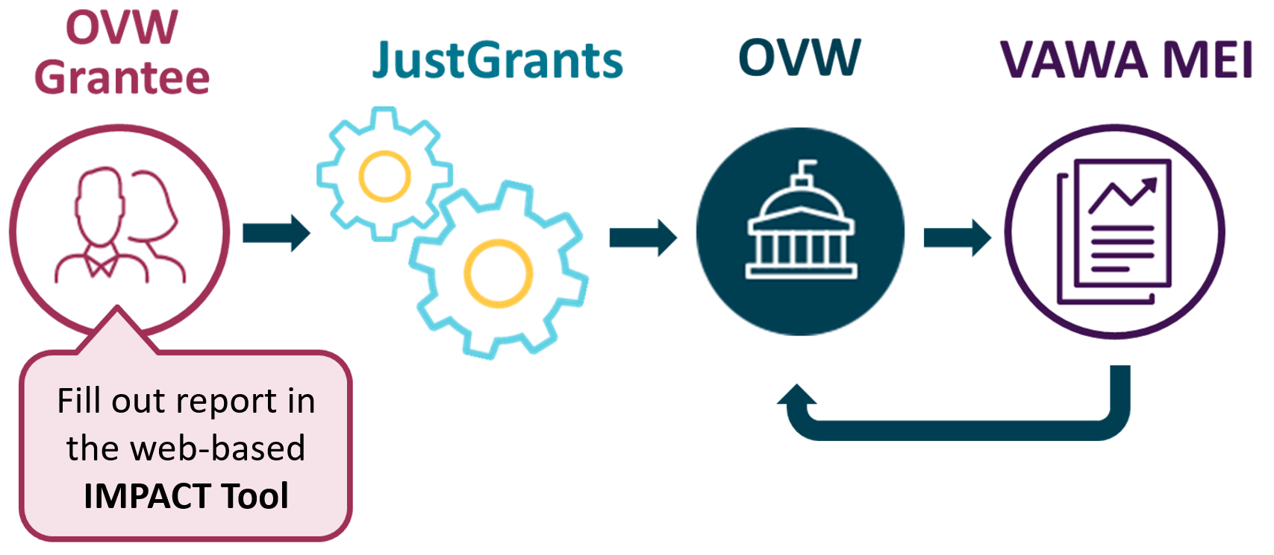
The Reporting Cycle
Notes:
Let’s begin with an overview of the overall reporting cycle.
Once you receive an OVW grant, it is your responsibility as a federal grantee to submit data on your funded program.
Every six months, grantees fill out a semi-annual performance report in the web-based IMPACT Tool, and then submit a PDF version of this completed report in the JustGrants System. This is the first reporting cycle that the IMPACT Tool is being used for Discretionary performance reporting. We'll talk more about this shortly!
Once the data is submitted in JustGrants, it is next reviewed by your OVW Program Specialist. They look at every report that is submitted by all VAWA grantees before they send the information on to us at VAWA MEI. They might contact you during their review, if they have a question about your report or to ask you to make a change to your report.
Once they have approved all the reports, they send the info on to us on the VAWA MEI team for what we call “cleaning the data.” My team reviews the data and looks for anything that may appear inconsistent or that may have been entered by mistake. While we go over the data, we may contact you with questions about what you have reported, in the interest of ensuring that your good work is reported as accurately and thoroughly as possible. If any changes need to be made at this point, we will make them on our end.
Once we have “cleaned” the data, we create reports for OVW summarizing the data reported for each discretionary grant, share them with OVW, and post them on our website.

Slide 15
Reporting in the VAWA IMPACT Tool
Grantees prepare their performance reports in the VAWA IMPACT Tool
This is a new web-based reporting tool for all OVW grantees
Grantees will be able to access the tool March 3, 2025
The July to Dec 2024 reporting due date has been pushed back 2 months!
Normal due date for Jul-Dec performance reports: January 30
Due date for Jul-Dec 2024 reports: March 31, 2025
Notes:
Now that we have talked about the overall reporting cycle, what will performance reporting look like for you as grantees specifically?
General logistics:
Grantees use the VAWA IMPACT tool to fill out their performance reports
This is a web-based reporting tool and it is a new for all OVW grantees - JD24 is the first reporting period in which we will be using the IMPACT tool for data reporting
We are really excited to roll out this new tool! One of the main goals of this tool is for it to be user friendly and to make performance reporting as smooth and easy as possible for you! But as with any new system, there might be some hiccups or questions along the way. Please remember that MEI is always here to help if you run into any issues or are ever unsure about how to navigate the IMPACT tool. We’ll do everything we can to make this a smooth experience for you!
And because the IMPACT tool is being newly rolled out for this upcoming reporting period:
Access to the IMPACT tool will be opened to grantees starting on March 3, 2025 – this is a bit later than it would usually be but there is some additional time needed to finalize everything before the launch of the tool
This means that OVW has pushed back the performance reporting deadline by two months for this reporting period. This is to ensure that you as grantees will still have enough time to familiarize themselves with the tool, reporting requirements, and to generate their reports after you get access to the tool. So instead of being due on January 30, 2025, performance reports will be due on March 31, 2025. – Remember, this will only be the case for this reporting period, after that we will go back to the usual reporting deadlines!

Slide 16
How to Fill Out Your Performance Report
URL for reporting form
via email from OVW or on MEI website
The reporting form consists of multiple sections covering various areas of grant-funded activities
Save entered data and return later to continue
Jump back and forth between sections
Built-in data validation notifications if there are issues with the entered data
Important: When completed, download a pdf file of the report!
Fill out performance report in the
IMPACT Tool
Download pdf file
Submit pdf file in your
JustGrants account
Notes:
In the second step, you fill out your performance report in the IMPACT Tool.
The reporting form consists of multiple sections to cover various areas of grant funded activities
Example: General grant information, Staff, Training, Victim Services, etc.
Some sections are mandatory for all grantees and you will need to fill them out, for example the general grant information section
Other sections are not mandatory and you need to determine if they apply to you. For non-mandatory sections, you will fill out the sections that correspond to the type of activities you used your grant funds for and you will skip all other sections that don’t apply to you
Example: If you used grant funds to provide trainings, you need to fill out the training section. If you did not use grant funds to provide trainings, you will skip the training section.
Some notes about navigating the reporting form in the IMPACT tool:
The form allows you to save your progress entering data and come back later to continue where you left off
It allows you to jump back and forth between sections
And the form has built-in data validations; This means that as you enter your data, if you accidentally skip a required form field or if there’s any issues with the data you entered, a little message will pop up and the form will ask you to fix those issues right away
And finally, VERY IMPORTANT: When you have completed your report in the IMPACT tool, you are not done yet! When your report is final, the IMPACT tool will generate a pdf version of your performance report and you need to download that pdf file.

Slide 17
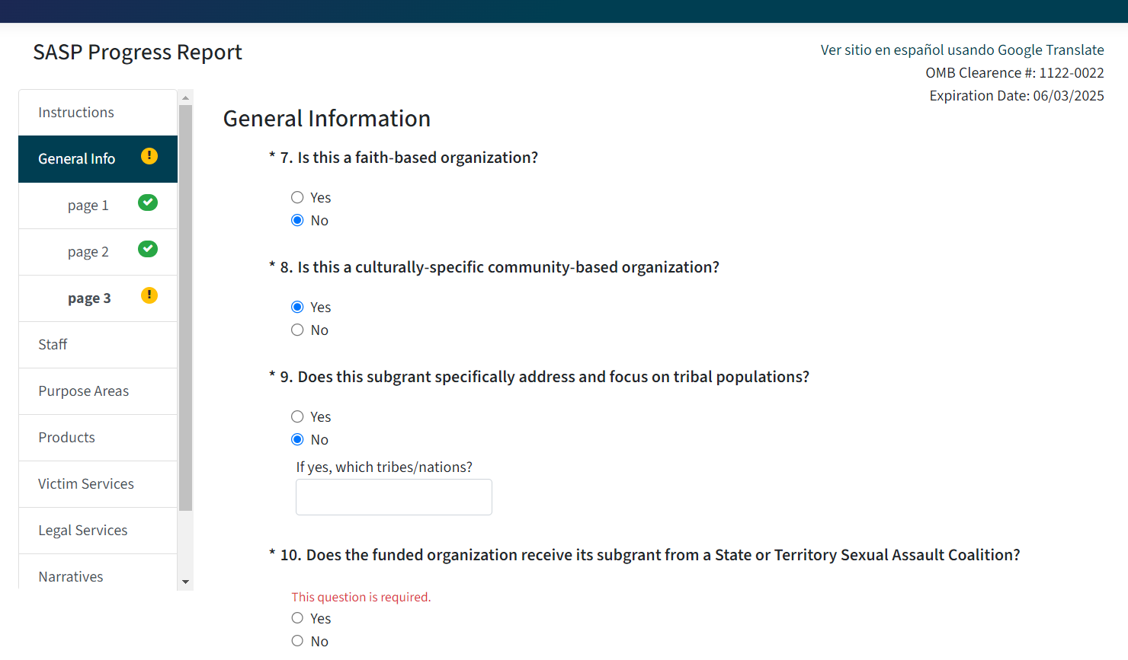
IMPACT Tool Example
SAMPLE
SAMPLE
Notes:
This slide shows a screenshot of a reporting form in the IMPACT tool. This is the reporting form from a different grant program, so the content of your form will not be exactly the same and your form will look a bit differently, but we wanted to show this as an example, so you know what to expect.
Point out aspects of the reporting form:
This screenshot shows part of the General Information section that every grantee would fill out in the beginning of the reporting form.
On the left you see the navigation pane with the various sections of the form. You can also use this to jump from section to section.
On the bottom, you see the two buttons to navigate through the form: you can to the previous page or the next page.
There is also the button to save your progress entering data, which then lets you leave the site and come back to it later to continue where you left off.
The screenshot also shows an example of a data validation message. All questions shown here are required questions that you have to answer, as indicated by the asterisk. And because I did not respond in question 10 and then clicked on “Save and Go To Next Page”, the form did not let me move to the next page but instead automatically reminded me with this pop up message in red that question 10 is required. Once I fix the error, in this case respond to question 10, the message will disappear and I can move on to the next section. You can also see the validation warning in the navigation pane on the left where there’s a yellow exclamation point symbol next to the section and the specific page where there is an issue with the data. Once all questions have been answered appropriately, each page and the overall section will get the green check mark, which tells you that the data in this section is good to go!

Slide 18
Key Changes
Training section will now report on the number of live training events, total professionals trained, the top three professionals trained, as well as the development of asynchronous (pre-recorded) training materials supported with OVW funds.
Education or public awareness section will now report on the number of live education events, the groups of people who were educated, as well as the development of Public Service Announcements or social media content supported with OVW funds.
Reduction in variables and data collected
Updated demographics sections

Slide 19
CY
Demographic and service information for children indirectly exposed will no longer be collected.
Legal services section added

Slide 20
EM
Section Removed: Planning and Development
Section Removed: Volunteer Activities
Section Removed: Community Organizing/Mobilization and Prevention Activities
Can be captured in the Community Education/Public Awareness section.

Slide 21
What have we learned from performance reporting?

Slide 22
“
We have three focus areas: primary prevention programing, outreach and awareness, and the ongoing support of the SAFE Men project. With grant funds, we are developing a primary prevention program for 8th and 9th grade boys to learn about healthy relationships. Local adults and university students will serve as mentors and guides to this group throughout the year.
”
-WYOMING COALITION AGAINST DOMESTIC VIOLENCE AND SEXUAL ASSAULT, 2021, VAWA 30 Report
12/10/24
22
Notes:
https://www.justice.gov/ovw/media/1367476/dl?inline

Slide 23
“
[After leaving a DV situation]. Residing with PADV the children were able to enjoy field trips during spring break, recreational activities at the shelter and summer camps once school ended for the summer. The children were full of joy and eager for the next events and outings.
”
-PARTNERSHIP AGAINST DOMESTIC VIOLENCE
J-J, 2022
12/10/24
23
Notes:
https://www.justice.gov/ovw/media/1367476/dl?inline

Slide 24
What we learned from performance reporting: (CY + EM)
Center for the Asian Pacific Family in California developed a training module on stalking and digital safety, entitled “Know It, Name It, Stop It.”
July to December 2021: 71 grantees reporting, 35% serving victims, 585 victims served
January to June 2022: 63 grantees, 33% serving victims, 555 victims served
63 grantees reported providing child advocacy services more than 440 times in a six-month period
12/10/24
24

Slide 25
Areas of Remaining Need
Scarcity of safe and affordable housing.
Lack of transportation, especially in rural, Tribal, and isolated communities.
Dearth of legal services that leaves survivors and their children vulnerable to ongoing abuse.
Lack of offender accountability.
Need to strengthen, modernize, and expand prevention and community education to stop violence before it starts.
Survivors not having enough money to meet their and their children’s basic needs.
Need to engage men and boys in prevention solutions and serve male victims.
12/10/24
25
Notes:
As is perennially the case, lack of safe and affordable housing was the hugest need cited by grantees and subgrantees, along with the need for material assistance, childcare, legal help, and transportation.
Flag: This is not a comprehensive list

Slide 26
OVW-Funded Research and Evaluation

Slide 27
OVW-funded Evidence: Youth
In a review of gender-specific prevention programs for sexual assault, results showed that programs tend to apply a heteronormative and traditionally gendered lens to prevention.
The programs aimed at women had a small effect on victimization, but no reported effects on perpetration of violence.
The programs for men did not have an effect on perpetration or victimization. (1)
A systematic review of campus violence prevention programs found a favorable effect on IPV knowledge, but no significant effect on attitudes, psychological victimization, psychological perpetration, physical victimization, or physical perpetration. (2)

Slide 28
OVW-funded Evidence: Youth
A survey of adults aged 18 to 35 found that nearly seven out of ten young adults reported any technology-facilitated abuse (TFA) victimization experience in their lifetime. Pervasive TFA was greater for women, LGBTQA+ young adults, and for individuals with a public following. (3)

Slide 29
OVW-Funded Evidence: Engaging Men
Evidence on batterer intervention programs is mixed. In a randomized control trial, an ACT-based group intervention delivered in community corrections reduced violent and nonviolent criminal charges. Domestic violence charges did not differ between groups, but victim reports indicated that ACT participants engaged in fewer IPV behaviors. (4)
Men who completed a 28-session community-informed and oppression-sensitive relationship violence intervention program had lower overall involvement with the criminal justice system.(5)

Slide 30
Questions?
12/10/24
30

Slide 31
Next Steps
Review form
MEI website
IMPACT Tool Opens
March 1st, 2025
Performance Report due
March 31^{st,} 2025

Slide 32
Become an OVW peer reviewer:
www.justice.gov/ovw/peer-review
Learn more about our grants at:
www.justice.gov/ovw/grant-programs
Review performance reporting forms:
https://www.vawamei.org/grant-program/consolidated-youth-program/
Contact Information:
Olivia Storz: Mary.Storz@usdoj.gov
R&E email inbox: OVW.Research@usdoj.gov
Thank you!

Slide 33
References
Kettrey, H. H., Thompson, M. P., Marx, R. A., & Davis, A. J. (2024). Who Is Considered a Potential Victim, Perpetrator, or Bystander? A Systematic Review and Meta-Analysis of Research Evaluating Gender-Specific Campus Sexual Assault Prevention Programs Implemented in the United States. Trauma, Violence, & Abuse, 15248380241271412.
Kettrey, H. H., Thompson, M. P., Marx, R. A., & Davis, A. J. (2023). Effects of campus intimate partner violence prevention programs on psychological and physical violence outcomes: A systematic review and meta-analysis. Journal of Experimental Criminology. https://doi.org/10.1007/s11292-023-09579-5
Mumford, E. A., Maitra, P., Sheridan, J., Rothman, E. F., Olsen, E., & Roberts, E. (2023). Technology-facilitated abuse of young adults in the United States: A latent class analysis. Cyberpsychology: Journal of Psychosocial Research on Cyberspace, 17(3), 3. https://doi.org/10.5817/CP2023-3-7
Zarling, A., & Russell, D. (2022). A randomized clinical trial of acceptance and commitment therapy and the Duluth Model classes for men court-mandated to a domestic violence program. Journal of Consulting and Clinical Psychology, 90(4), 326–338. https://doi.org/10.1037/ccp0000722
Murphy, C. M., Richards, T. N., Nitsch, L. J., Green-Manning, A., Brokmeier, A. M., LaMotte, A. D., & Holliday, C. N. (2021). Community-informed relationship violence intervention in a high-stress, low-income urban context. Psychology of violence, 11(6), 509.

